Slide 1
CSE 3400/CSE 5850 - Introduction to Computer & Network Security / Introduction to Cybersecurity Lecture 10 Public Key Cryptography– Part I
Ghada Almashaqbeh
UConn
*Adapted from the textbook slides

Slide 2
Outline
Introduction to public key cryptography and motivation.
Number theory review.
The discrete log assumption.
The Diffie-Hellman key exchange protocol.
2

Slide 3
Intro to Public Key Cryptography
3

Slide 4
Public Key Cryptography
Kerckhoff’s principle: the cryptosystem (algorithm) is public
What we learned until now: symmetric or shared key setting
Only the key is secret (unknown to attacker)
Same key for encryption and decryption ➔ if you can encrypt, you can also decrypt!
Shared keys for MACs and PRFs, etc.
But can we give asymmetric cryptographic capability, e.g., encryption capability without a decryption capability?
Yes, using public key cryptography!

Slide 5
Public Key Cryptosystem (PKC)
Kerckhoff: cryptosystem (algorithm) is public.
[DH76]: can encryption key be public, too??
Decryption key will be different (and private).
Everybody can send me emails, only I can read them.
Key length l
KeyGen KG
Encryption Key e
(public)
(e,d)
Decryption Key d
(private)
e
d
Plaintext
m
Encrypt E
Ciphertext c=E_{e}(m)
Decrypt D
Plaintext m=D_{d}(E_{e}(m))

Slide 6
Is it Only About Encryption?
Also: Digital signatures for integrity and non-repudiation.
Sign with private key s, verify with public key v
(Recall MACs; a shared key cryptosystem for message authentication).
Key length l
KeyGen KG
(s,v)
Private signing key s
Public validation key v
s
v
Sign S
m, σ=S_{s}(m)
Validate V
m if V_{v}(m, σ)=OK
Error otherwise
Message m
Anyone can verify the signature!

Slide 7
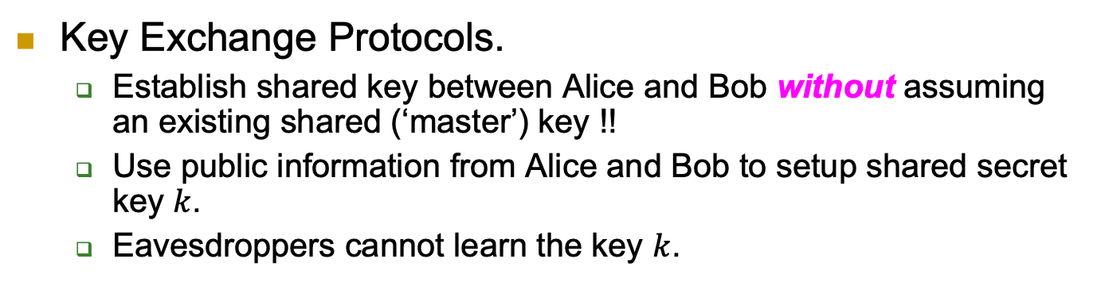
More: Key-Exchange Protocol
Key Exchange Protocols.
Establish shared key between Alice and Bob without assuming an existing shared (‘master’) key !!
Use public information from Alice and Bob to setup shared secret key $k$.
Eavesdroppers cannot learn the key $k$.

Slide 8
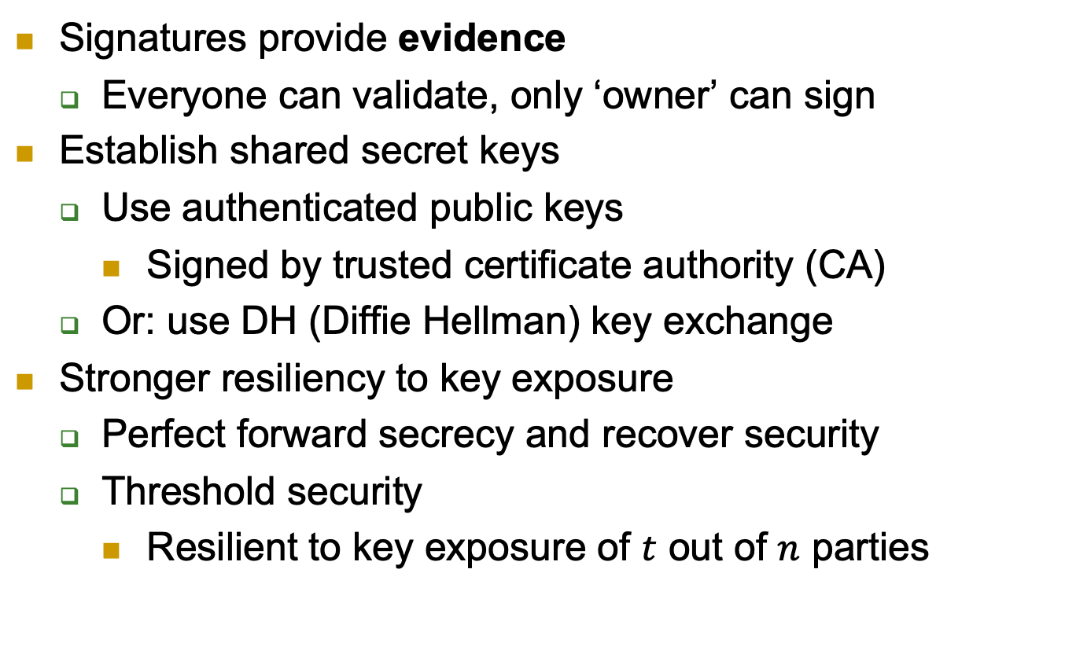
Public keys solve more problems …
Signatures provide evidence
Everyone can validate, only ‘owner’ can sign
Establish shared secret keys
Use authenticated public keys
Signed by trusted certificate authority (CA)
Or: use DH (Diffie Hellman) key exchange
Stronger resiliency to key exposure
Perfect forward secrecy and recover security
Threshold security
Resilient to key exposure of $t$ out of $n$ parties

Slide 9
Public keys are easier…
To distribute:
From directory or from incoming message (still need to be authenticated)
Less keys to distribute (same public key to all)
To maintain:
Can keep in non-secure storage as long as being validated (e.g. using MAC) before using
Less keys: O(|parties|), not O(|parties|²)
So: why not always use public key crypto?

Slide 10
The Price of PKC
Assumptions
Applied PKC algorithms are based on a small number of specific computational assumptions
Mainly: hardness of factoring and discrete-log
Both may fail against quantum computers
Overhead
Computational
Key length
Output length (e.g., ciphertext or signature)

Slide 11
Public key crypto is harder…
Requires related public, private keys
Usually we say a keypair (pk, sk)
Public key does not expose private key
Substantial overhead
Successful cryptanalytic shortcuts → need long keys
Elliptic Curves (EC) may allow shorter key (almost no shortcuts found)
Complex computations, e.g., complex (slow) key generation
Commercial-grade security from [LV02]
[LV02] | Required key size
Year | AES | RSA, DH | ECIES
2010 | 78 | 1369 | 160
2020 | 86 | 1881 | 161
2030 | 93 | 2493 | 176
2040 | 101 | 3214 | 191
For the table:
The year indicates until when confidentiality to be preserved.
AES: A symmetric encryption scheme
RSA and DH: encryption schemes based on factoring and discrete log hardness problems
ECIES: Elliptic Curve Integrated Encryption Scheme

Slide 12
In Sum
Minimize the use of PKC
In particular: as possible, apply PKC only to short inputs
How??
For signatures:
Hash-then-sign
For public-key encryption:
Hybrid encryption

Slide 13
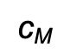
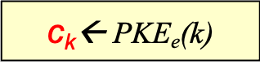

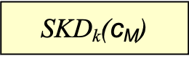
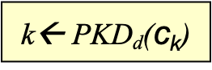
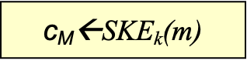
Hybrid Encryption
Challenge: public key cryptosystems are slow
Hybrid encryption:
Use a shared key encryption scheme to encrypt all messages.
But use a public key encryption system to exchange the shared key.
Alice generates k, encrypts it under Bob’s public key and sends the ciphertext c_{k} to Bob.
Bob can decrypt and recover k, and then use k to decrypt c_{M}.
Encryption
Decryption
k ←{0,1}^{n}
$$\text{c}\text{k}$$
$\text{c}\text{k}$← PKE_{e}(k)
k← PKD_{d}($\text{c}\text{k}$)
Plaintext m
$$\text{c}\text{M}$$
m
$\text{c}\text{M}$←SKE_{k}(m)
SKD_{k}($\text{c}\text{M}$)
Note: the figure above only focuses on confidentiality, additional modules are needed to ensure integrity.
Notes:
13
10/30/11

Slide 14
Going Forward
First, introduce the mathematical concepts (mainly number theory) that we need for a particular primitive/protocol.
This would involve hardness problems/assumptions.
Then, study the primitive/protocol itself.
Lastly, and as before, show correctness and reason about security.
In general, security will be based on mathematical hardness problems.

Slide 15
Number Theory Review --Modular Arithmetic--
15

Slide 16
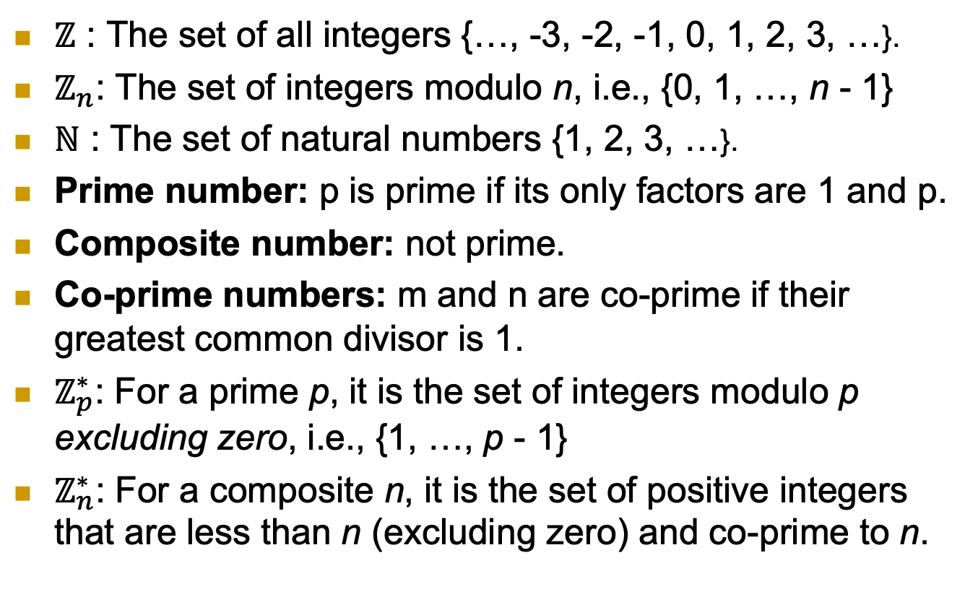
Notation
$ℤ$ : The set of all integers {…, -3, -2, -1, 0, 1, 2, 3, …}.
$ℤ_{n}$: The set of integers modulo n, i.e., {0, 1, …, n - 1}
$ℕ$ : The set of natural numbers {1, 2, 3, …}.
Prime number: p is prime if its only factors are 1 and p.
Composite number: not prime.
Co-prime numbers: m and n are co-prime if their greatest common divisor is 1.
$ℤ_{p}^{∗}$: For a prime p, it is the set of integers modulo p excluding zero, i.e., {1, …, p - 1}
$ℤ_{n}^{∗}$: For a composite n, it is the set of positive integers that are less than n (excluding zero) and co-prime to n.
16

Slide 17
The Modulo Operation
Properties (make it easier to compute complex modular arithmetic expressions):
17

Slide 18
Examples
7 mod 9 = ?
13 mod 8 = ?
0 mod 11 = ?
4 mod 4 = ?
(30 + 66) mod 11 = ?
How about:
18

Slide 19
Multiplicative Inverse
Needed to support division in modular arithmetic.
Division does not always produce integers.
Modular arithmetic requires integers to work with!!
To compute a/c mod m, multiply a by the multiplicative inverse of c.
That is compute a/c mod m = ac⁻¹ mod m.
Where c⁻¹ is the multiplicative inverse such that cc⁻¹ mod m = 1
Not all integers have multiplicative inverses with respect to a specific modulus m.
19

Slide 20
Multiplicative Inverse
Examples:
3/5 mod 4 = 3 . 5⁻¹ mod 4 = ?
3/5 mod 6 = 3 . 5⁻¹ mod 6 = ?
The algorithm used to compute the inverse is called the Extended Euclidean algorithm (out of scope for this course).
20

Slide 21
Modular Exponentiation
Will be encountered a lot; discrete log-based scheme, RSA, etc.
We have seen a property to reduce the base, but how about the exponent?
Its reduction will be with respect to a different modulus than the one in the original operation.
Fermat’s Little Theorem:
21

Slide 22
Modular Exponentiation
Examples; Use Fermat’s Little theorem (if applicable) to solve the following:
13³² mod 31 = ?
19⁹³⁰ mod 4 = ?
19⁶⁰ mod 7 = ?
Can we reduce the exponent for non-prime (composite) modulus?
We can use Euler’s Theorem.
22

Slide 23
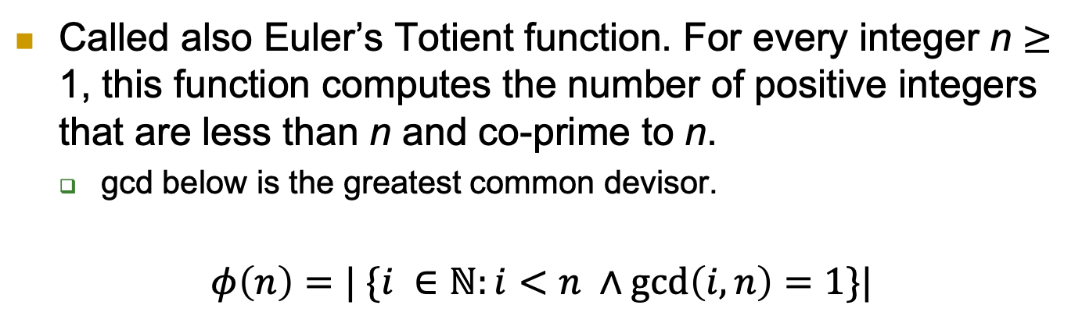
Euler’s Function
Called also Euler’s Totient function. For every integer n $≥$ 1, this function computes the number of positive integers that are less than n and co-prime to n.
gcd below is the greatest common devisor.
$$φ\left(n\right)=| \{i ∈ℕ:i<n ∧\gcd\left(i, n\right)=1\}|$$
Examples:
23

Slide 24
Euler’s Function Properties
24

Slide 25
Euler’s Theorem
Examples:
13³¹ mod 31 = ?
27²⁶ mod 10 = ?
25

Slide 26
Key Exchange
26

Slide 27



The Key Exchange Problem
Aka key agreement
Alice and Bob want to agree on secret (key)
Secure against eavesdropper adversary
Assume no prior shared secrets (key)

Slide 28
Defining a Key Exchange Protocol
*KG: Key Generate, KC: Key Compute, a and b are secret, while P_{A} and P_{B} are public
Must satisfy:
Correctness; both parties compute the same shared key,
and key indistinguishability; the key that the two parties establish is indistinguishable from random.

Slide 29
Discrete Log (DL) Assumption
29

Slide 30
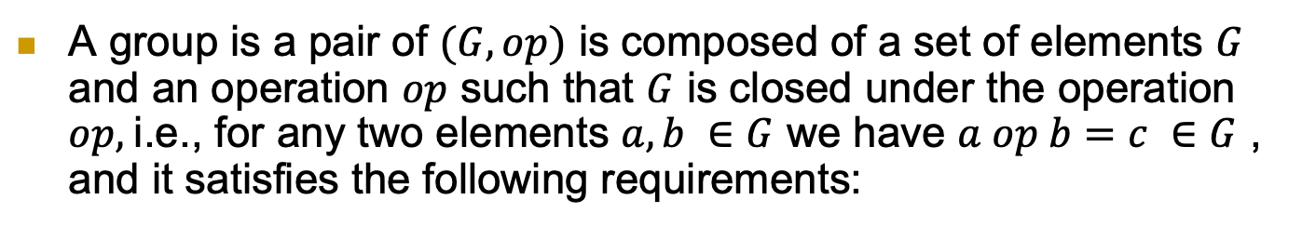
--Group Theory Review--
A group is a pair of $(G, op)$ is composed of a set of elements $G$ and an operation $op$ such that $G$ is closed under the operation $op,$i.e., for any two elements $a, b ∈G$ we have $a op b=c ∈G$ , and it satisfies the following requirements:
Although the properties are for multiplication operations, same applies for addition. The only different is that the identity element is 0.
Notes:
$ℤ_{p}^{∗}$ contains element of$ℤ_{p}^{}$ which are relatively-prime to p, i.e., gcd(a,p)=1; for prime p this holds for entire $ℤ_{p}^{}, i.e.ℤ_{p}^{∗}=ℤ_{p}^{}$
Evidences of intentional manipulation of crypto choices in few cases, e.g., Juniper Network ‘16.

Slide 31
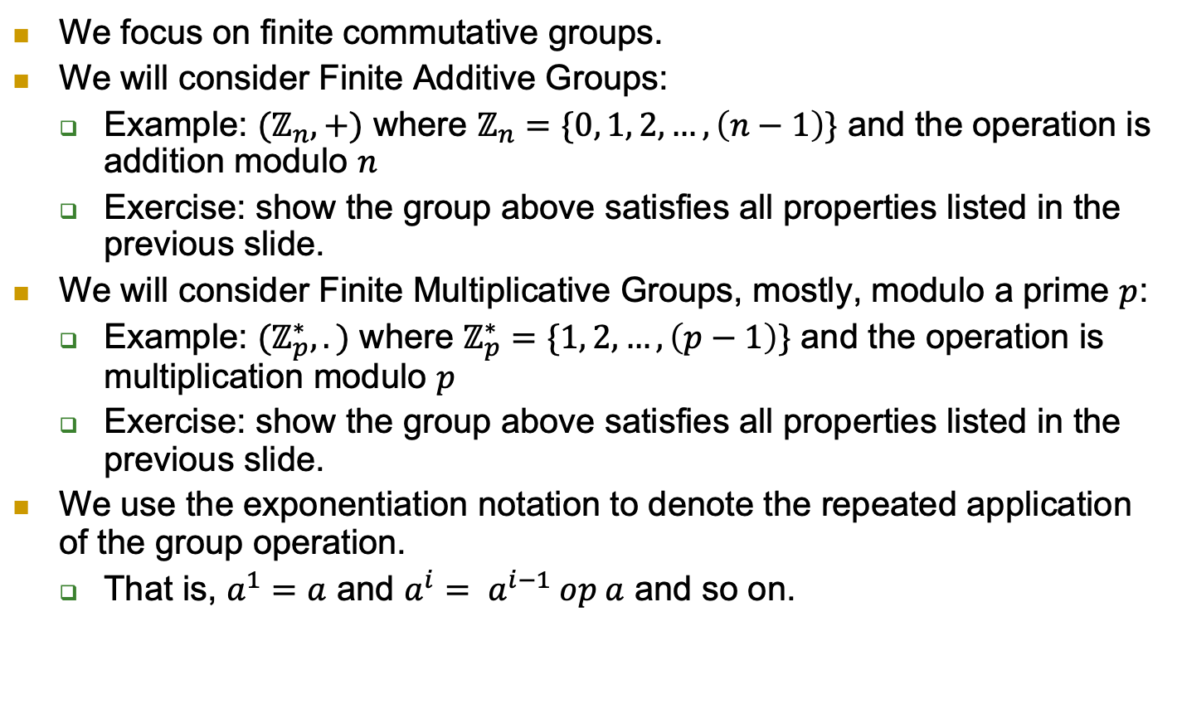
--Group Theory Review--
We focus on finite commutative groups.
We will consider Finite Additive Groups:
Example: $(ℤ_{n}, +)$ where $ℤ_{n}=\{0, 1, 2, …, \left(n−1\right)\}$ and the operation is addition modulo $n$
Exercise: show the group above satisfies all properties listed in the previous slide.
We will consider Finite Multiplicative Groups, mostly, modulo a prime $p$:
Example: $(ℤ_{p}^{∗}, .)$ where $ℤ_{p}^{∗}=\{1, 2, …, \left(p−1\right)\}$ and the operation is multiplication modulo $p$
Exercise: show the group above satisfies all properties listed in the previous slide.
We use the exponentiation notation to denote the repeated application of the group operation.
That is, $a^{1}=a$ and $a^{i}= a^{i−1} op a$ and so on.
Notes:
$ℤ_{p}^{∗}$ contains element of$ℤ_{p}^{}$ which are relatively-prime to p, i.e., gcd(a,p)=1; for prime p this holds for entire $ℤ_{p}^{}, i.e.ℤ_{p}^{∗}=ℤ_{p}^{}$
Evidences of intentional manipulation of crypto choices in few cases, e.g., Juniper Network ‘16.

Slide 32
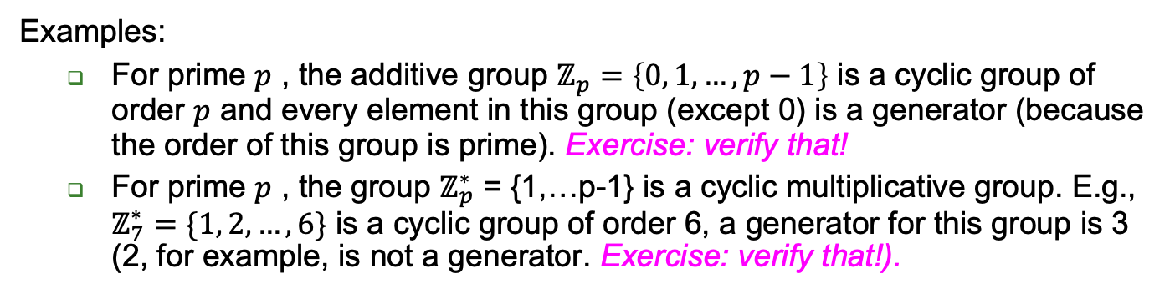
--Cyclic Groups--
Examples:
For prime $p$ , the additive group $ℤ_{p}=\left\{0, 1, …, p−1\right\}$ is a cyclic group of order $p$ and every element in this group (except 0) is a generator (because the order of this group is prime). Exercise: verify that!
For prime $p$ , the group $ℤ_{p}^{∗}$ = {1,…p-1} is a cyclic multiplicative group. E.g., $ℤ_{7}^{∗}=\{1, 2, …, 6\}$ is a cyclic group of order 6, a generator for this group is 3 (2, for example, is not a generator. Exercise: verify that!).
Notes:
$ℤ_{p}^{∗}$ contains element of$ℤ_{p}^{}$ which are relatively-prime to p, i.e., gcd(a,p)=1; for prime p this holds for entire $ℤ_{p}^{}, i.e.ℤ_{p}^{∗}=ℤ_{p}^{}$
Evidences of intentional manipulation of crypto choices in few cases, e.g., Juniper Network ‘16.

Slide 33
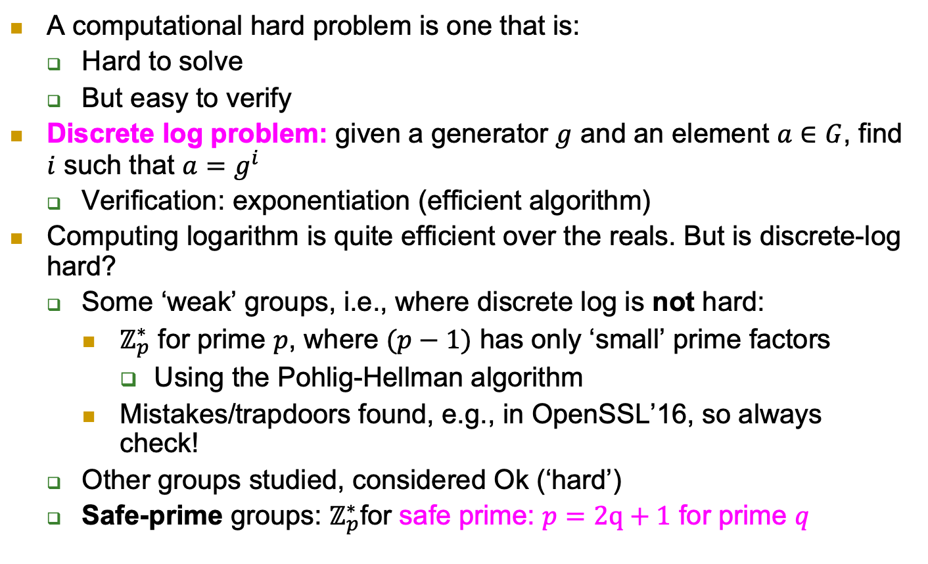
The Discrete Log Problem
A computational hard problem is one that is:
Hard to solve
But easy to verify
Discrete log problem: given a generator $g$ and an element $a∈G$, find $i$ such that $a=g^{i}$
Verification: exponentiation (efficient algorithm)
Computing logarithm is quite efficient over the reals. But is discrete-log hard?
Some ‘weak’ groups, i.e., where discrete log is not hard:
$ℤ_{p}^{∗}$ for prime $p$, where $(p−1)$ has only ‘small’ prime factors
Using the Pohlig-Hellman algorithm
Mistakes/trapdoors found, e.g., in OpenSSL’16, so always check!
Other groups studied, considered Ok (‘hard’)
Safe-prime groups: $ℤ_{p}^{∗}$for safe prime: $p=2q+1$ for prime $q$
Notes:
$ℤ_{p}^{∗}$ contains element of$ℤ_{p}^{}$ which are relatively-prime to p, i.e., gcd(a,p)=1; for prime p this holds for entire $ℤ_{p}^{}, i.e.ℤ_{p}^{∗}=ℤ_{p}^{}$
Evidences of intentional manipulation of crypto choices in few cases, e.g., Juniper Network ‘16.

Slide 34


Discrete Log Assumption
q -1
And remember, discrete-log is hard with respect to a particular group!

Slide 35
The Diffie-Hellman (DH) Key Exchange Protocol and The Computational/Decisional Diffie-Hellman Assumptions (CDH/DDH)
35

Slide 36
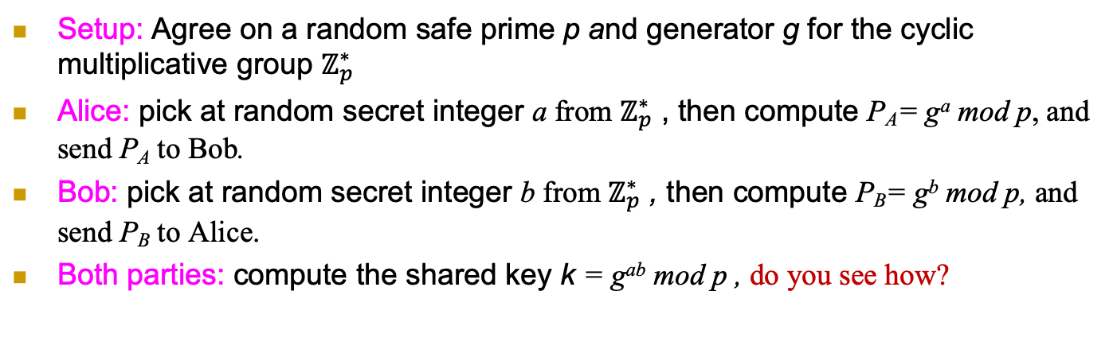
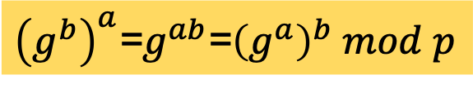
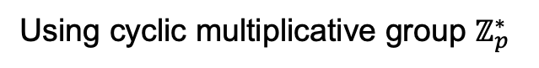
Diffie-Hellman [DH] Key Exchange
Using cyclic multiplicative group $ℤ_{p}^{∗}$
Setup: Agree on a random safe prime p and generator g for the cyclic multiplicative group $ℤ_{p}^{∗}$
Alice: pick at random secret integer a from $ℤ_{p}^{∗}$ , then compute P_{A}= gª mod p, and send P_{A} to Bob.
Bob: pick at random secret integer b from $ℤ_{p}^{∗}$ , then compute P_{B}= g^{b} mod p, and send P_{B} to Alice.
Both parties: compute the shared key k = g^{ab} mod p , do you see how?
Alice
Bob
Select a
P_{A}= gª mod p
Select b
P_{B}= g^{b} mod p
${\left(g^{b}\right)}^{a}$=$g^{ab}$=${\left(g^{a}\right)}^{b} mod p$

Slide 37
Caution: Authenticate Public Keys!
Diffie-Hellman key exchange is only secure against eavesdroppers but not MitM attackers.
So the public messages being sent must be authenticated, e.g., using digital signatures.
Still each party must have a certificate for her public (verification) key.

Slide 38
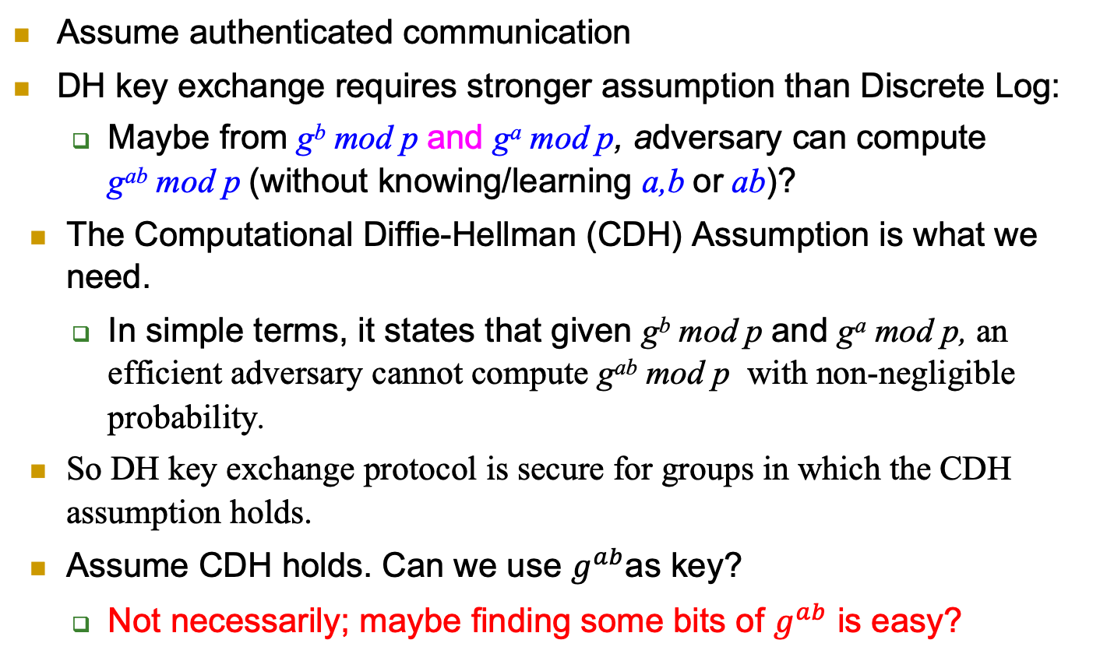
Security of [DH] Key Exchange
Assume authenticated communication
DH key exchange requires stronger assumption than Discrete Log:
Maybe from g^{b} mod p and gª mod p, adversary can compute g^{ab} mod p (without knowing/learning a,b or ab)?
The Computational Diffie-Hellman (CDH) Assumption is what we need.
In simple terms, it states that given g^{b} mod p and gª mod p, an efficient adversary cannot compute g^{ab} mod p with non-negligible probability.
So DH key exchange protocol is secure for groups in which the CDH assumption holds.
Assume CDH holds. Can we use $g^{ab}$as key?
Not necessarily; maybe finding some bits of $g^{ab}$ is easy?

Slide 39
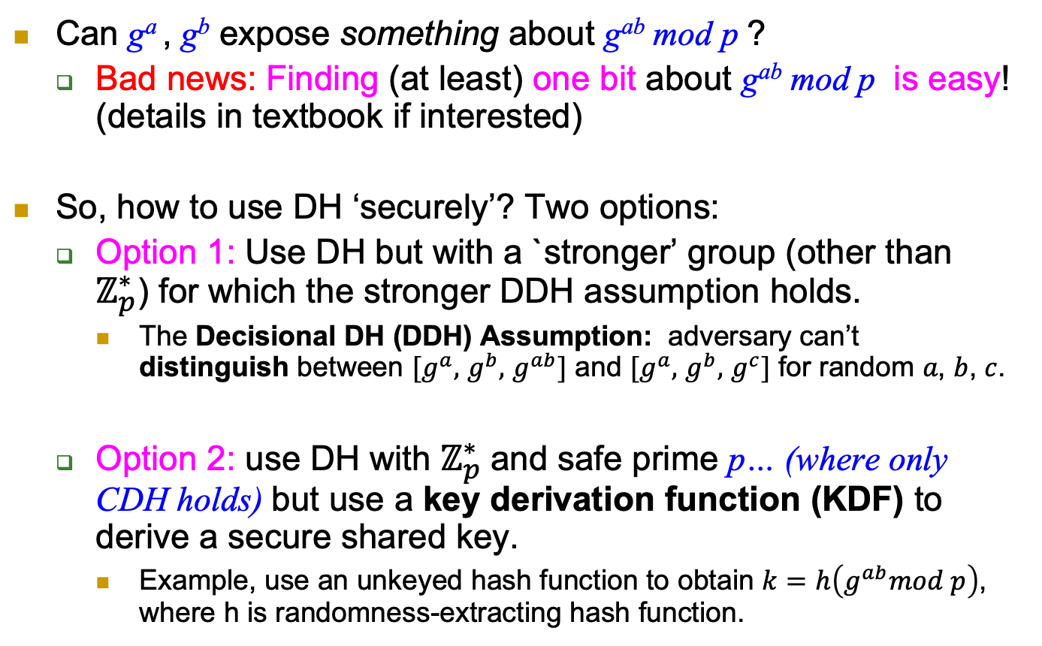
Using DH securely?
Can gª , g^{b} expose something about g^{ab} mod p ?
Bad news: Finding (at least) one bit about g^{ab} mod p is easy! (details in textbook if interested)
So, how to use DH ‘securely’? Two options:
Option 1: Use DH but with a `stronger’ group (other than $ℤ_{p}^{∗}$) for which the stronger DDH assumption holds.
The Decisional DH (DDH) Assumption: adversary can’t distinguish between $[g^{a},$ $g^{b},$ $g^{ab}]$ and $[g^{a},$ $g^{b},$ $g^{c}]$ for random 𝑎, 𝑏, 𝑐.
Option 2: use DH with $ℤ_{p}^{∗}$and safe prime p… (where only CDH holds) but use a key derivation function (KDF) to derive a secure shared key.
Example, use an unkeyed hash function to obtain $k=h\left(g^{ab}mod p\right)$, where h is randomness-extracting hash function.
Notes:
Exercise: show how to compute Legenre of g^ab !

Slide 40
Covered Material From the Textbook
Appendix A.2
Chapter 6:
Sections 6.1 (except 6.1.8.3),
Section 6.2 (except 6.2.5, also 6.2.1 and 6.2.3 are optional reading),

Slide 41

Thank You!

